Slide 1

The Avalanche Effect

Slide 2
Avalanche effect and Diodes
Avalanche Diodes are a specific type of diode that uses the avalanche effect.
The avalanche effect is an occurrence in diodes that causes a sudden increase in conductivity when a particular voltage, called the breakdown voltage, is reached. [1]

Slide 3
Avalanche breakdown
Avalanche breakdown occurs at high voltages when diodes are hooked up in what’s called reverse bias.
When in reverse bias, current is prohibited from flowing until the breakdown voltage is reached.
Current increases when the breakdown voltage is reached, however this can occur from the avalanche effector and/or the zener effect. [2]

Slide 4
How does it happen?
When the voltage builds, an electric field is produced causing electrons to move through the diode.
When the breakdown voltage is reached, the field is strong enough to move the electron very quickly.
This allows the electron to “knock out” other electrons and for them to move just like the originating electron.
These electrons go on to do the same to other electrons causing an avalanche.

Slide 5
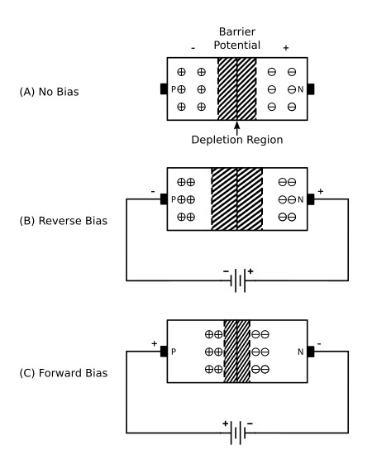
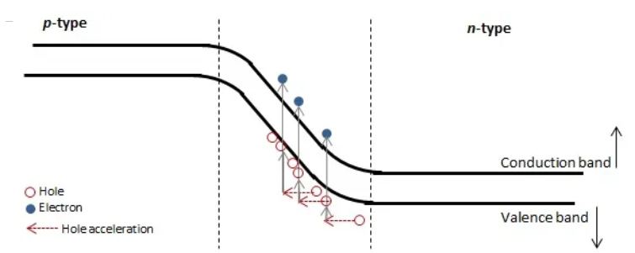

Slide 6
Avalanche vs Zener
While they go hand-n-hand, these two effects are different.
The avalanche effect typically occurs beyond 5 volts.
The zener effect typically occurs before 5 volts.
                [3]
Avalanche Effect | Zener Effect
Happens in slightly doped diodes | Happens in highly doped diodes
Breakdown curve is extended and slight | Breakdown is acutely angled
Temperature and voltage are correlated | Temperature and voltage are inversely correlated
Collisions of free electrons | From electric field in reverse bias

Slide 7
Application
Avalanche diodes are typically used for unwanted voltages to be sent directly to ground.
Can be used for might noise generators
The avalanche effect can also used in photodiodes for:
  High-speed laser scanners
  Imaging
  Laser microscopy
  Optical-time domain reflectometers (OTDR)
  Range finding
  Receivers in optical fiber communications

Slide 8
conclusion
The avalanche effect is an increase of conductivity in a diode in reverse bias when the breakdown voltage is reached
Electrons collide with one another to create an avalanche of electrons
Avalanche diodes are typically used for unwanted voltages like in a surge protector.

Slide 9
Sources
[1] https://eng.libretexts.org/Bookshelves/Materials_Science/Supplemental_Modules_(Materials_Science)/Solar_Basics/D._P-N_Junction_Diodes/II._P-N_Junction/3%3A_Reverse_Bias#:~:text=The%20avalanche%20effect%20occurs%20when%20the%20potential%20difference,them.%20This%20collision%20creates%20a%20new%20electron-hole%20pair.
[2] https://www.electrical4u.com/avalanche-diode/
[3] https://www.vedantu.com/question-answer/distinguish-between-avalanche-breakdown-and-class-12-physics-cbse-5f39dd9e0fb754474e4ca0da
[4] https://en.wikipedia.org/wiki/Avalanche_breakdown
[5] https://ecstudiosystems.com/discover/textbooks/solid-state-devices/special-devices/zener-diode/

